Slide 1
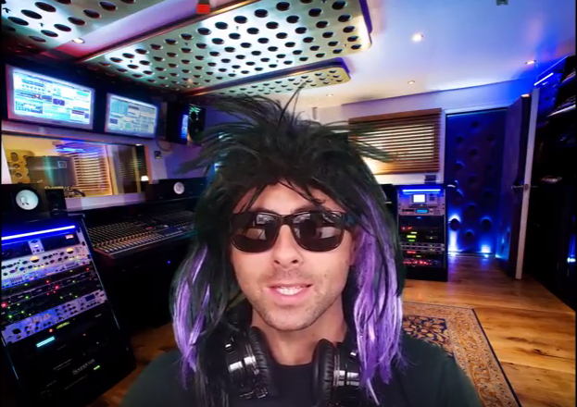
https://www.youtube.com/watch?v=p72cgbzdJBE
Launch Video
[Optional]
@TTRockStars
ttrockstars.com

Slide 2
Why is it important to know your times tables off by heart?
@TTRockStars
ttrockstars.com

Slide 3
This slide is hidden.
You can take pupils’ responses for the “why is it helpful” question although most will say that it helps you with shopping, which is really only true if you’re buying lots of the same item or working in sales.
We’ve offered two possible reasons on the next few slides:
Times tables are one of the foundations/building blocks of maths. You need it to access/support all the even more interesting maths that sits on top.
The multiplicative relationship between amounts is usually more interesting and helpful than the additive relationship as they allow you to describe patterns and make predictions.
The second argument may be lost on younger children so don’t feel you have to use it.
@TTRockStars
ttrockstars.com

Slide 4
If maths was a house…
All the even more super fun stuff
Graphs, shapes & algebra
Fractions & %
× and ÷
+ and –
Counting
@TTRockStars
ttrockstars.com

Slide 5
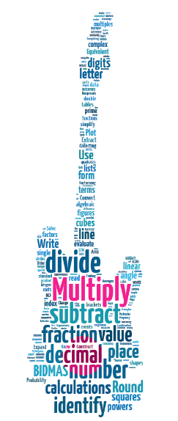
The times tables are the basics of maths. If you know the basics, you’ll find the rest much much easier.
@TTRockStars
ttrockstars.com
Notes:
This is saying largely what the previous slide but with a different image.
You might be interested to know that the word cloud was based on an analysis of GCSE topics by Will Emeny (Great Maths Teaching Ideas). The thing that came out on top (in terms of direct and indirect application in GCSE maths) was times tables. Nearly 60% of GCSE topics could be traced to a root in times tables.

Slide 6
First you add 1, then 2 more, then 4 more…
+4
+2
+1
@TTRockStars
ttrockstars.com
Notes:
Additive relationship – watch how the shape is growing

Slide 7
?
What comes next?
The pattern isn’t easy to see.
?
?
+8?
+7?
+6?
+4
+2
+1
@TTRockStars
ttrockstars.com
Notes:
Additive relationship – the shape has been growing. What will the next shape in the pattern be?

Slide 8
Introducing…
@TTRockStars
ttrockstars.com

Slide 9
Baz Wynter
@TTRockStars
ttrockstars.com

Slide 10
Double it each time.
×2
×2
×2
@TTRockStars
ttrockstars.com
Notes:
Multiplicative relationship – better for describing patterns and therefore better for predicting

Slide 11
What comes next?
The pattern is easy to see.
×2
×2
×2
×2
@TTRockStars
ttrockstars.com
Notes:
Multiplicative relationship helps us work out that the next shape will be 16 blocks tall.

Slide 12
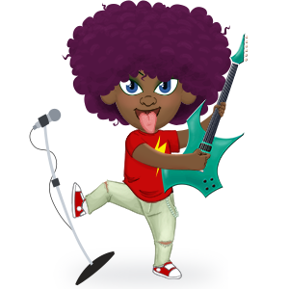
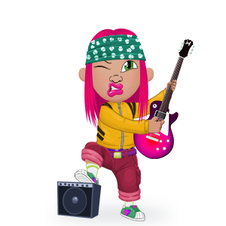
OK, times tables are important but I find them hard to remember.
And not much fun to learn.
So what’s the plan?

Slide 13
@TTRockStars
ttrockstars.com

Slide 14
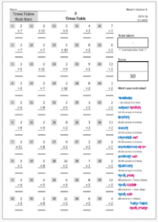
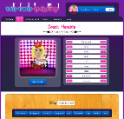
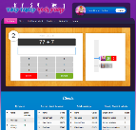
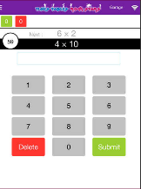
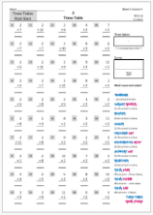
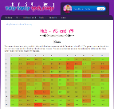
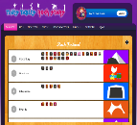
Three Modes
Lesson 1
Lesson 2
Lesson 3
Lesson 4
Lesson 5
Paper
Website
App
@TTRockStars
ttrockstars.com

Slide 15
Paper version
Lesson 1
Lesson 2
Lesson 3
Lesson 4
Lesson 5
Time 1
Score 1
Time 2
Score 2
+
Time 3
+
Score 3
Time 4
Score 4
Time 5
Score 5
 3 mins
 3 mins
Total Time
Total Score
 3 mins
 3 mins
 3 mins
@TTRockStars
ttrockstars.com

Slide 16
Total Time
Rock speed
(seconds per question)
÷
Total Score
@TTRockStars
ttrockstars.com

Slide 17
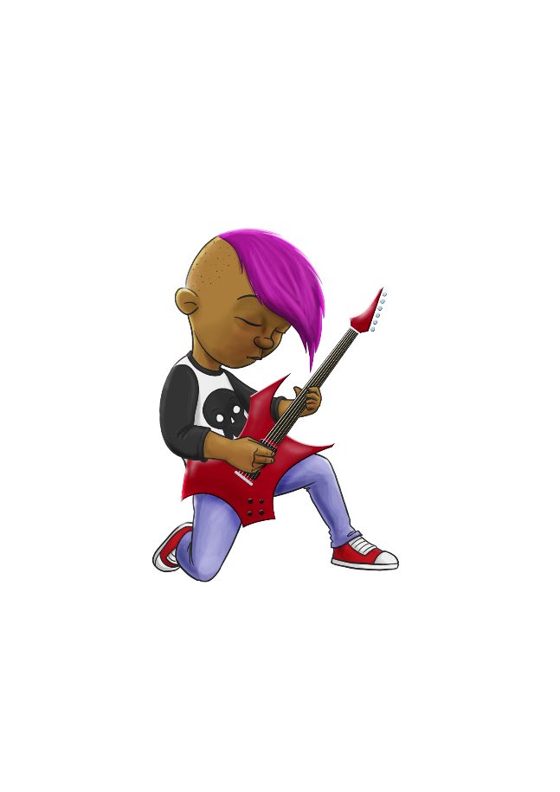
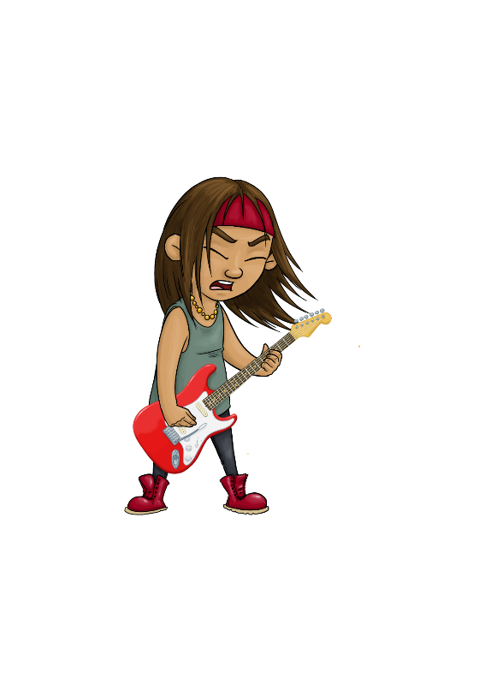
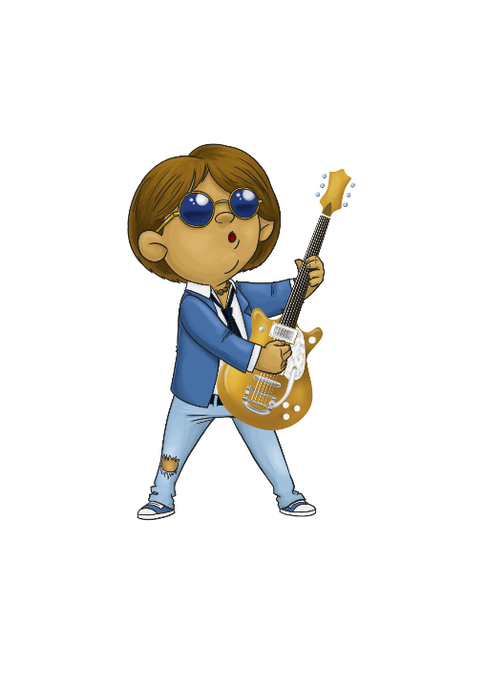
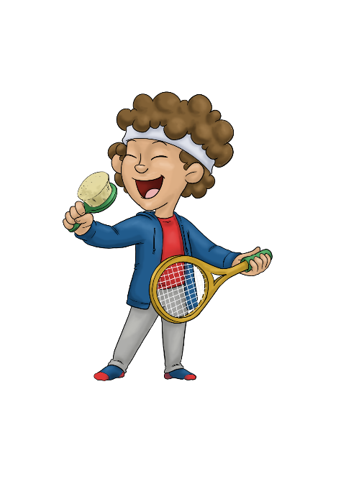
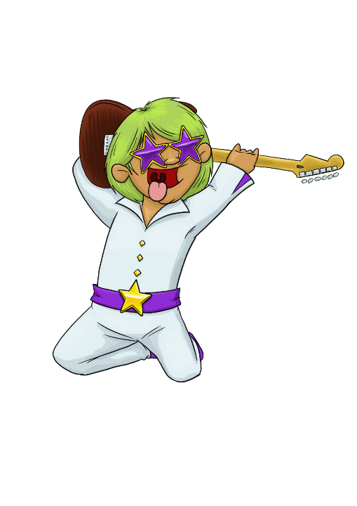
Rock speed
(seconds per question)
Rock Star
3 seconds/question
Rock Hero
one second
per question
Breakthrough Artist
6 seconds/question
Garage Rocker
10 seconds/question
Support Act
5 seconds/question
Busker
9 seconds/question
Unsigned Act
7 seconds/question
Rock Legend
2 seconds/question
Gigger
8 seconds/question
Wannabe
+10 seconds/question
Headliner
4 seconds/question
@TTRockStars
ttrockstars.com
Total Time
÷
Total Score

Slide 18
Website
•
1 minute games
Single player
Or
Multi-player
Earn & spend on your avatar
@TTRockStars
ttrockstars.com

Slide 19
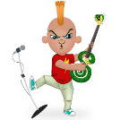
@TTRockStars
ttrockstars.com

Slide 20
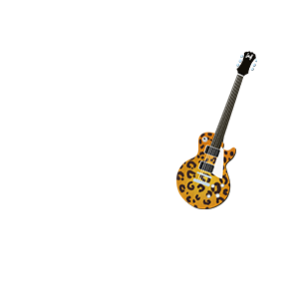
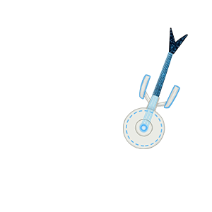
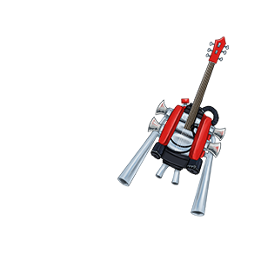
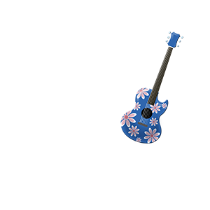
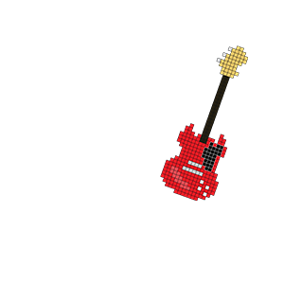
@TTRockStars
ttrockstars.com

Slide 21
Your teacher will now explain the next steps.
Enjoy!
@TTRockStars
ttrockstars.com

Slide 22
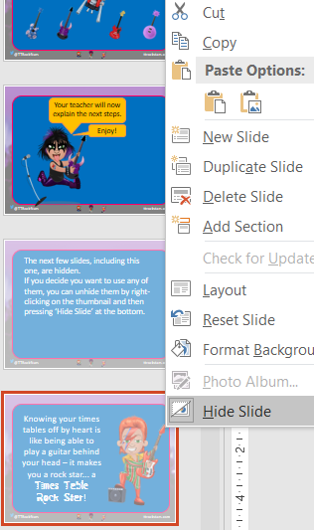
The next few slides, including this one, are hidden.
If you decide you want to use any of them, you can unhide them by right-clicking on the thumbnail and then pressing ‘Hide Slide’ at the bottom.
@TTRockStars
ttrockstars.com

Slide 23
App
Earn & spend on your avatar
Single player
Or
Multi-player
•
1 minute games
@TTRockStars
ttrockstars.com
Notes:
Show this slide instead of slide 17 if you’re going to be using the app rather than the website.
Remember, to use the app, your school must have the Mobile Apps bolt-on. Go to Subscription Details once you’ve logged in to find out if you have it enabled.

Slide 24
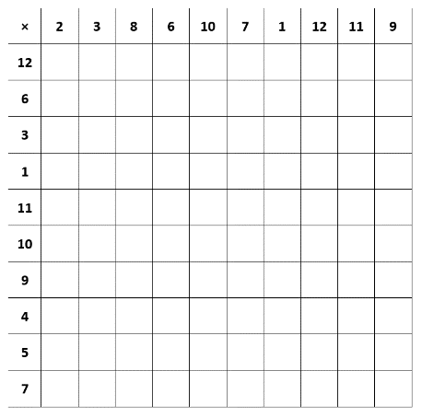
Baseline Quiz
Remember to cross-multiply!
You can start with your favourite rows or favourite columns.
5 minute time limit.
Start when the teacher says
@TTRockStars
ttrockstars.com
Notes:
Show this if you’re going to do the baseline grid (from the Downloads page) in the lesson.

Slide 25
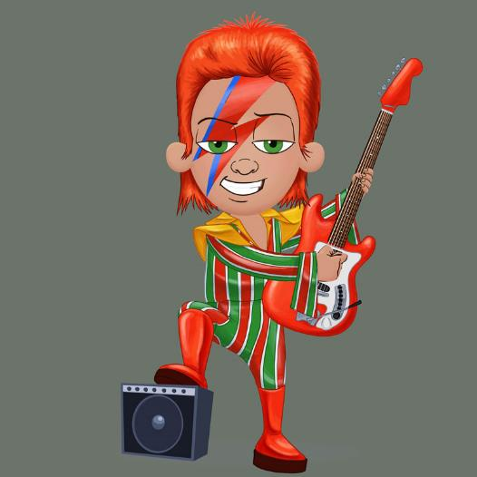
Knowing your times tables off by heart is like being able to play a guitar behind your head – it makes you a rock star... a Times Table Rock Star!
@TTRockStars
ttrockstars.com

Slide 26
I've played in some amazing concert venues in my time and let me tell you, performing to a crowd of 90,000 screaming fans gives you the most incredible feeling; the only thing I can compare it to is the feeling I get from knowing my multiplication facts.
@TTRockStars
ttrockstars.com

Slide 27
Speak to any of my rock legend friends, McCartney, Hendrix, Bono, Collins, Springsteen, Rose, etc., and they will tell you the hours they spent practising guitar chords and drumming riffs. It's just the same with times tables – all wannabe rock stars need to
@TTRockStars
ttrockstars.com

Slide 28
practise and practise and practise. So, I say to you, pick up your hairbrush, your air guitar and your pots-and-pans drumkit, get your friends together and start making music! And while you're at it, why not learn your times tables?
Ziggy Stardust
@TTRockStars
ttrockstars.com

Slide 29
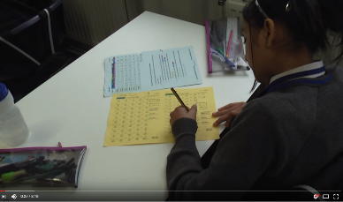
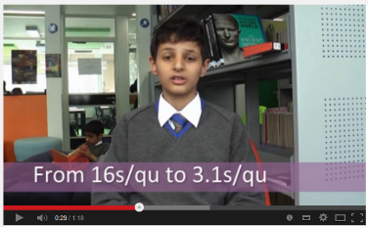
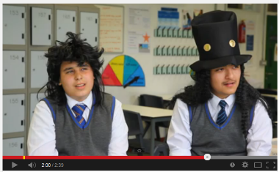
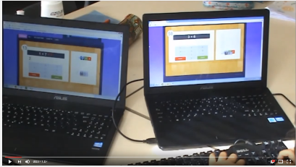
How much can you improve?
Times Tables Rock Stars intro
What is it like to be a Rock God?
High Score
@TTRockStars
ttrockstars.com

